Slide 1

ILP 2021 – W1S2 On variables, math operators, comments, printing and getting
Matthieu DE MARI – Singapore University of Technology and Design

Slide 2
Outline (Week1, Session2 – W1S2)
Variables: Naming conventions, types, IDs, assignments, conversions
Basic math operators in Python: +, -, *, /, //, %, **
Combining operators and assignments
Commenting: in-line, block, docstring and header comments
Printing and getting: displaying with print(), getting with input()
Bonus (out-of-class, if time allows!): what happens backstage when I run my code?

Slide 3
Some admin stuff.
No news so far about classes going back online.
If that changes,
I will keep you posted.
I will provide Zoom details via email.
This class was designed to be taught online (and was taught online last year, so we are prepared!)

Slide 4
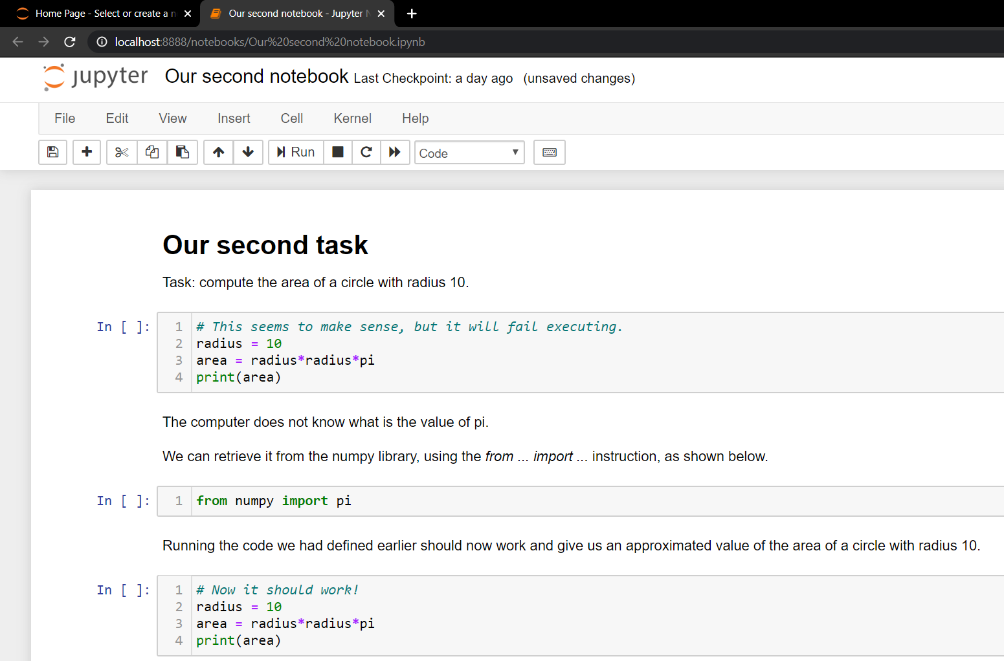
Recall: our second task

Slide 5
Recall: our second task
In this task, we have intuitively used a few concepts, such as:
Assigning values to memory (variables)
Using basic math operations
Commenting your code
Printing
Executing a coding script in console or an IDE
→ In the next couple of slides, we will go deeper into these concepts

Slide 6
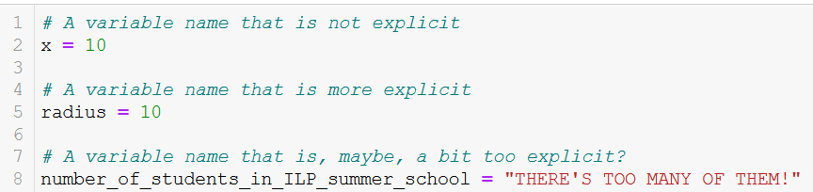
About variables names
Variables names can include any combination of letters (both lowercase and uppercase), digits and underscore symbols (_).
You can use the underscore symbol as a separator to make variables names a bit more explicit.

Slide 7

Matt’s Great advice #2
Matt’s Great Advice #2: make your variables names explicit.
It is a good idea to make your variables names explicit, rather than using meaningless ones that leave your reader guessing (x, y, a, b1, c2, etc.).
You can use underscores if you find it helpful (e.g. current_year = 2020).
Your future self, and colleagues, will thank you, when they work on your code later on.

Slide 8
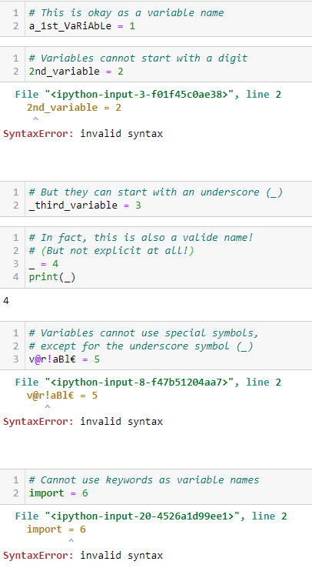
About variables names
Variables names can include any combination of letters (both lowercase and uppercase), digits and underscore symbols (_).
However,
They cannot start with a digit, or use special characters other than underscores.
They may also not use some reserved keywords (e.g. import, print, etc.)

Slide 9
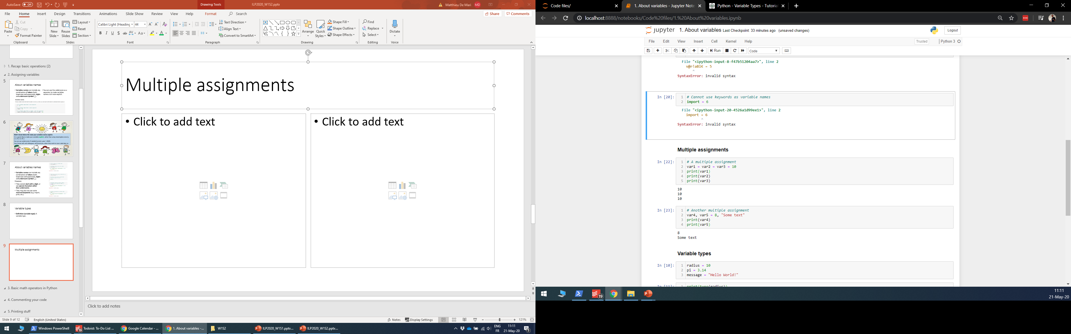
Multiple assignments
Python also allows multiple assignments using
Successive multiple equal signs: the value on the far right is assigned to all variables names on the left side of an equal sign.

Slide 10
Multiple assignments
Python also allows multiple assignments using
Successive multiple equal signs: the value on the far right is assigned to all variables names on the left side of an equal sign.
Or by having several variables names and values separated by commas on both sides: the values are respectively assigned to the variables names.

Slide 11
Variable types
Definition (variable type/class): Everything is stored in memory as 0s and 1s. A variable type/class defines how the sequence of 0s and 1s should be interpreted.

Slide 12
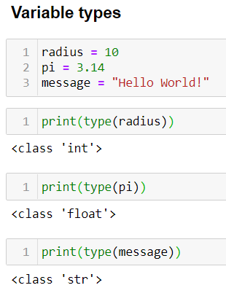
Variable types
Definition (variable type/class): Everything is stored in memory as 0s and 1s. A variable type/class defines how the sequence of 0s and 1s should be interpreted.
Let us start with three basic types
int: an integer number.
float: a floating point number, for decimal numbers.
str: a string of text.

Slide 13
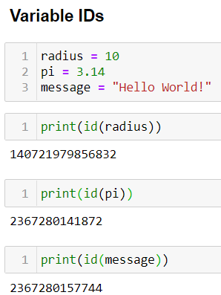
Variable IDs
Definition (variable ID): Everything is stored in memory as 0s and 1s. A variable ID returns an integer number, corresponding to a memory address where the variable is being stored in memory.
This is automatically handled by your computer. More on this later, so let us keep it in mind.

Slide 14
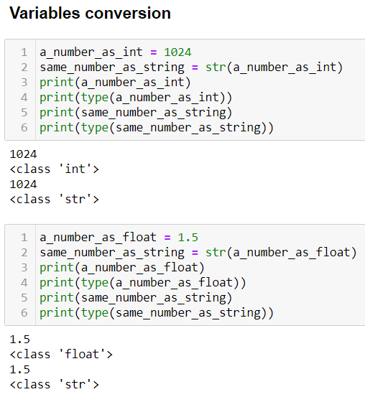
Type conversion
Int/Float -> String: You can convert any int/float to a string using the str() function.

Slide 15
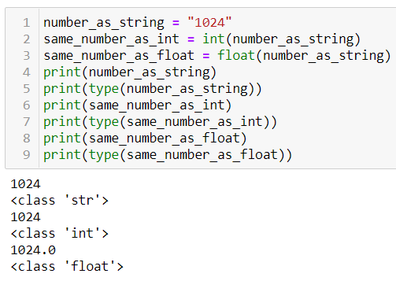
Type conversion
String -> Int/Float: You can convert a string of digits to an int/float using int() or float().

Slide 16
Type conversion
String -> Int/Float: You can convert a string of digits to an int/float using int() or float().
Note: You can convert a string of digits with a single decimal point to a float.

Slide 17
Type conversion
String -> Int/Float: You can convert a string of digits to an int/float using int() or float().
Note: You can convert a string of digits with a single decimal point to a float.
Also: if the string includes a decimal point, it cannot be converted to int.

Slide 18
Type conversion
String -> Int/Float: You can convert a string of digits to an int/float using int() or float().
Note: You can convert a string of digits with a single decimal point to a float.
Also: if the string includes a decimal point, it cannot be converted to int.
Important note: if the string contains non-digits characters, the conversion fails.

Slide 19
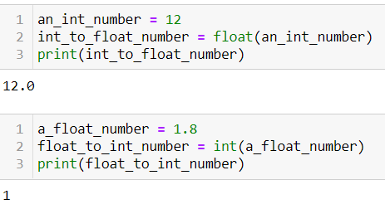
Type conversion
Int <-> Float: You can convert a float to an int and vice versa.
Note that,
Converting from int to float adds a single 0 decimal.
Converting from float to int, will drop all decimals (i.e. a truncation of all decimals).

Slide 20
Python basic operators
By default, Python comes with a few basic math operators, for number (int/float) variables.

Slide 21
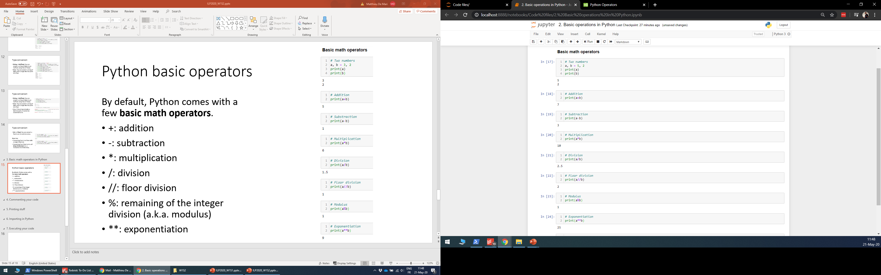
Python basic operators
By default, Python comes with a few basic math operators, for number (int/float) variables.
+: addition
-: subtraction
*: multiplication

Slide 22
Python basic operators
By default, Python comes with a few basic math operators, for number (int/float) variables.
+: addition
-: subtraction
*: multiplication
/: division
//: integer division
%: remaining of the integer division (a.k.a. modulus)
**: exponentiation

Slide 23
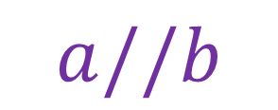

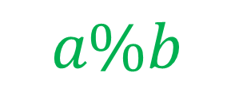



Python basic operators
By default, Python comes with a few basic math operators, for number (int/float) variables.
+: addition
-: subtraction
*: multiplication
/: division
//: integer division
%: remaining of the integer division (a.k.a. modulus)
**: exponentiation
$$5$$
$$2$$
$$1$$
$$2$$
$$a\%b$$
$$a//b$$

Slide 24
Python basic operators
By default, Python comes with a few basic math operators, for number (int/float) variables.
+: addition
-: subtraction
*: multiplication
/: division
//: integer division
%: remaining of the integer division (a.k.a. modulus)
**: exponentiation

Slide 25
Python basic operators
By default, Python comes with a few basic math operators, for number (int/float) variables.
+: addition
-: subtraction
*: multiplication
/: division
//: integer division
%: remaining of the integer division (a.k.a. modulus)
**: exponentiation

Slide 26
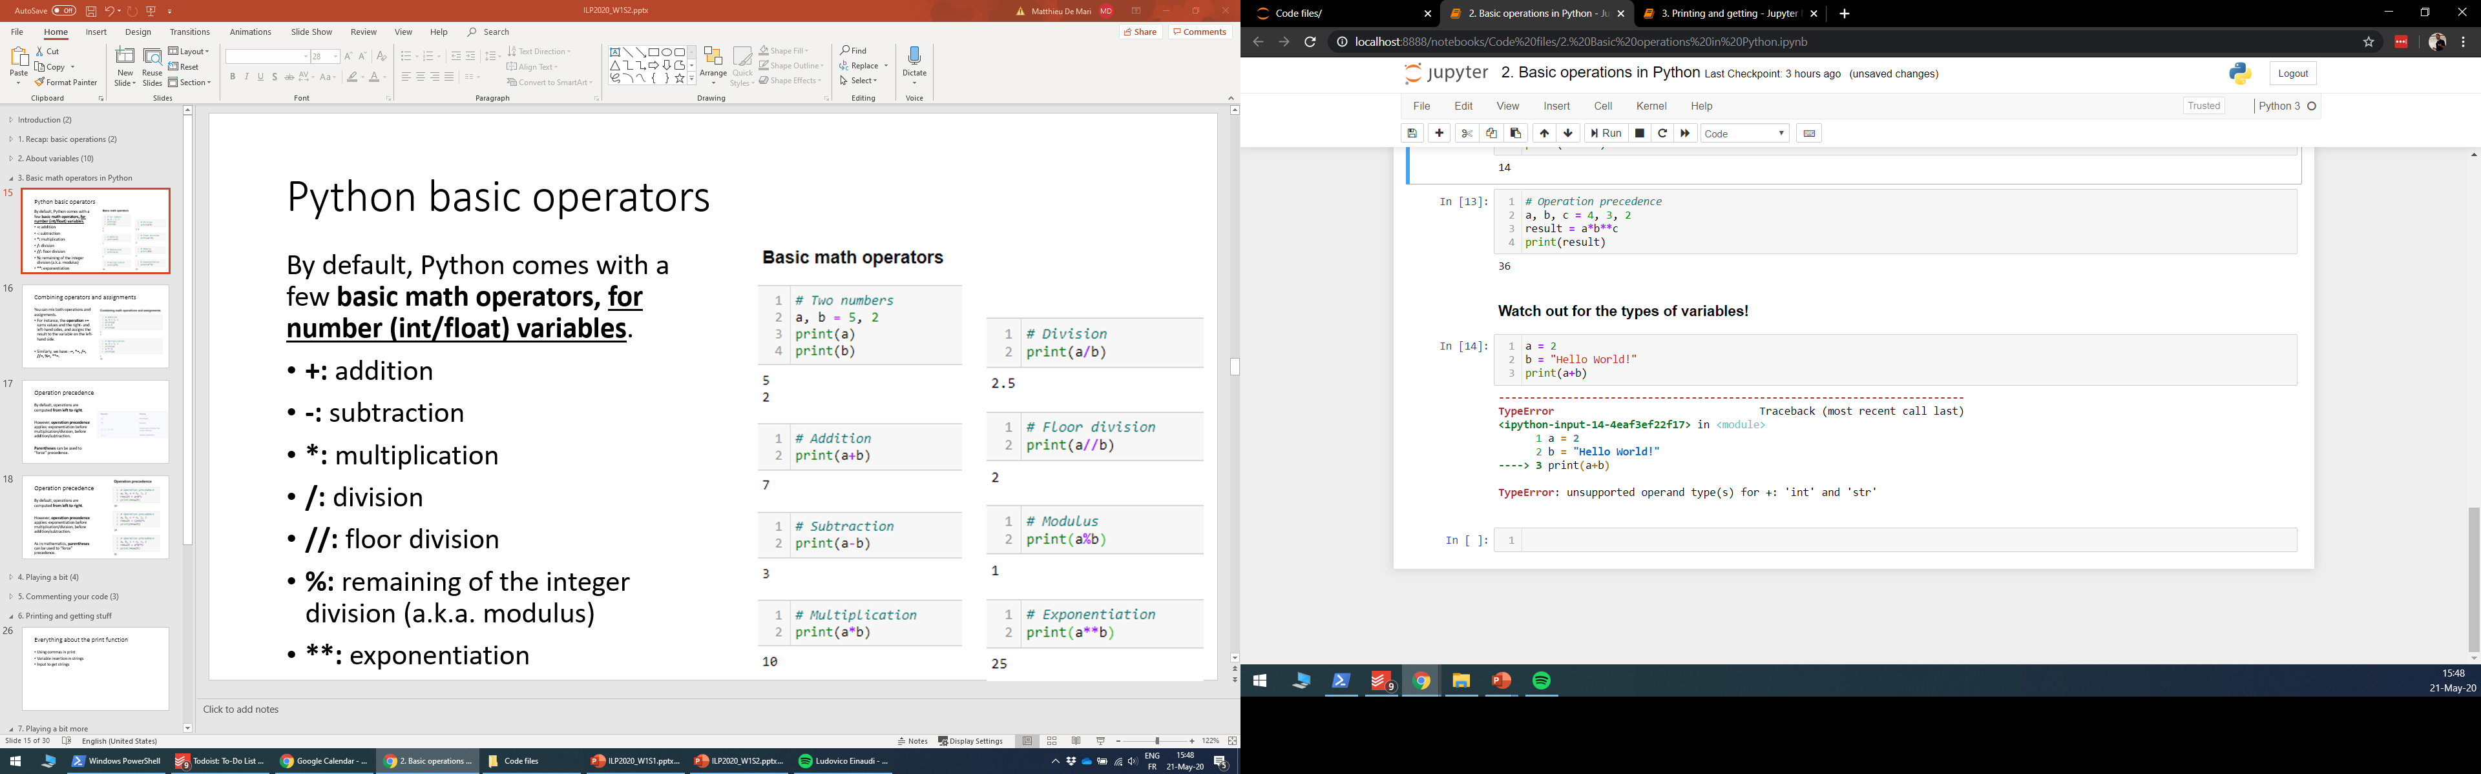
Python basic operators
By default, Python comes with a few basic math operators, for number (int/float) variables.
+: addition
-: subtraction
*: multiplication
/: division
//: integer division
%: remaining of the integer division (a.k.a. modulus)
**: exponentiation

Slide 27
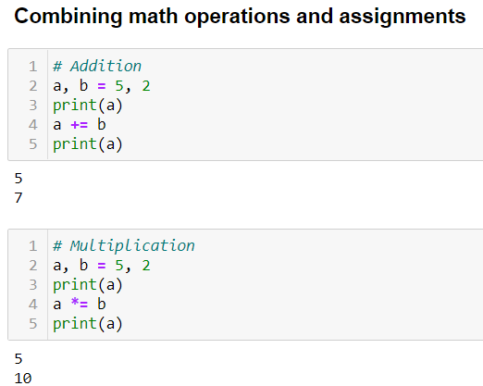
Combining operators and assignments
You can mix both operations and assignments.
For instance, the operation += sums values and the right- and left-hand sides, and assigns the result to the variable on the left-hand side.

Slide 28
Combining operators and assignments
You can mix both operations and assignments.
For instance, the operation += sums values and the right- and left-hand sides, and assigns the result to the variable on the left-hand side.
Similarly, we have: -=, *=, /=, //=, %=, **=.

Slide 29
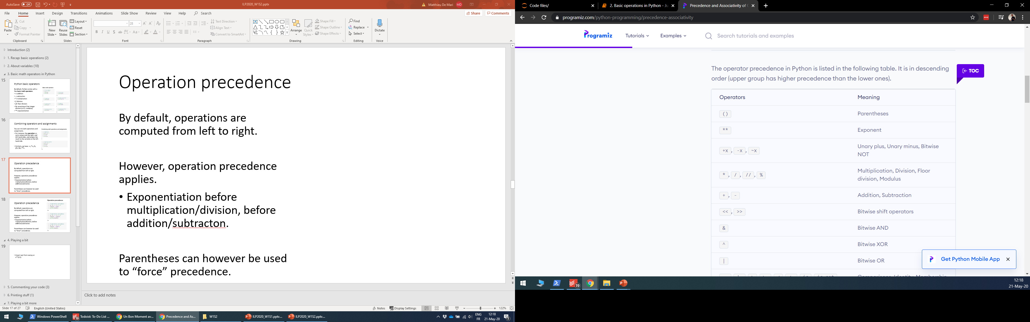
Operation precedence
By default, operations are computed from left to right.

Slide 30
Operation precedence
By default, operations are computed from left to right.
However, operation precedence applies: exponentiations before multiplications/divisions, before additions/subtractions.

Slide 31
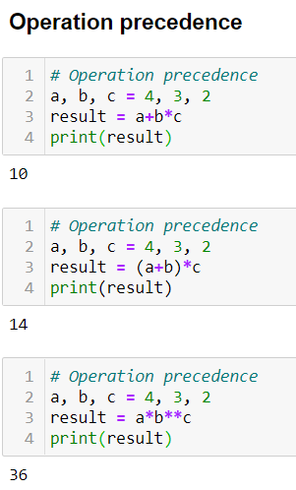
Operation precedence
By default, operations are computed from left to right.
However, operation precedence applies: exponentiations before multiplications/divisions, before additions/subtractions.
As in mathematics, parentheses can be used to “force” precedence.

Slide 32
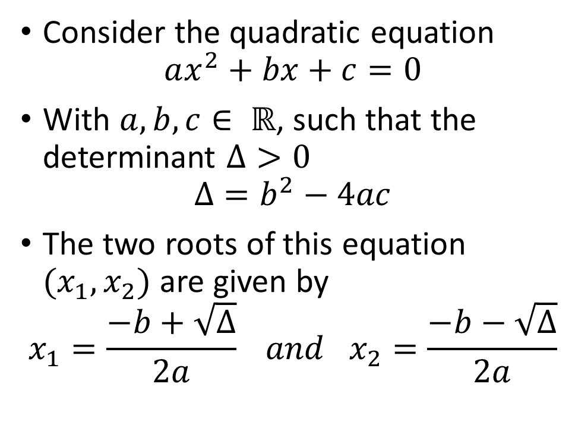
Activity 1: compute the roots of a quadratic equation, with strictly positive determinant
Consider the quadratic equation
$$ax^{2}+bx+c=0$$
With $a, b, c∈ ℝ$, such that the determinant $Δ>0$
$$Δ=b^{2}−4ac$$
The two roots of this equation $(x_{1},x_{2})$ are given by
$$x_{1}=\frac{−b+\sqrt{Δ}}{2a} and x_{2}=\frac{−b−\sqrt{Δ}}{2a}$$

Slide 33
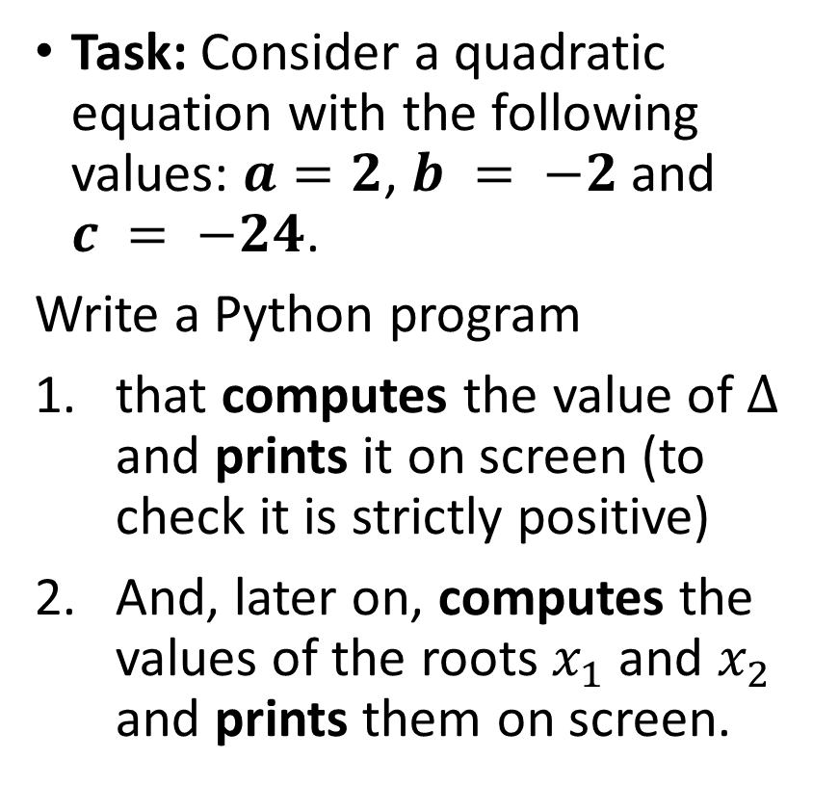
Activity 1: compute the roots of a quadratic equation, with strictly positive determinant
Consider the quadratic equation
$$ax^{2}+bx+c=0$$
With $a, b, c∈ ℝ$, such that the determinant $Δ>0$
$$Δ=b^{2}−4ac$$
The two roots of this equation $(x_{1},x_{2})$ are given by
$$x_{1}=\frac{−b+\sqrt{Δ}}{2a} and x_{2}=\frac{−b−\sqrt{Δ}}{2a}$$
Task: Consider a quadratic equation with the following values: $a=2$, $b = −2$and $c = −24$.
Write a Python program
that computes the value of $Δ$ and prints it on screen (to check it is strictly positive)
And, later on, computes the values of the roots $x_{1}$ and $x_{2}$ and prints them on screen.

Slide 34
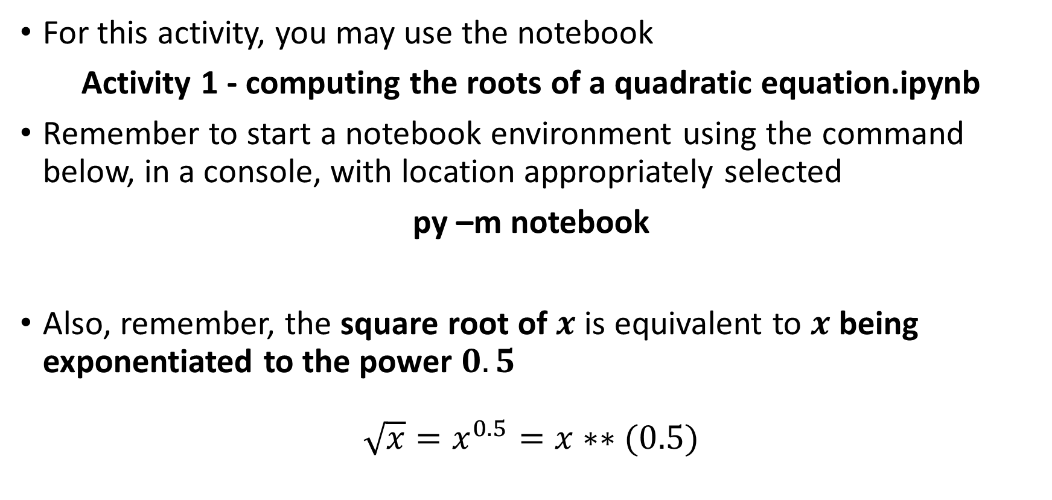
Activity 1: compute the roots of a quadratic equation, with strictly positive determinant
For this activity, you may use the notebook
Activity 1 - computing the roots of a quadratic equation.ipynb
Remember to start a notebook environment using the command below, in a console, with location appropriately selected
py –m notebook
Also, remember, the square root of $x$ is equivalent to $x$ being exponentiated to the power $0.5$
$$\sqrt{x}=x^{0.5}=x∗∗(0.5)$$

Slide 35
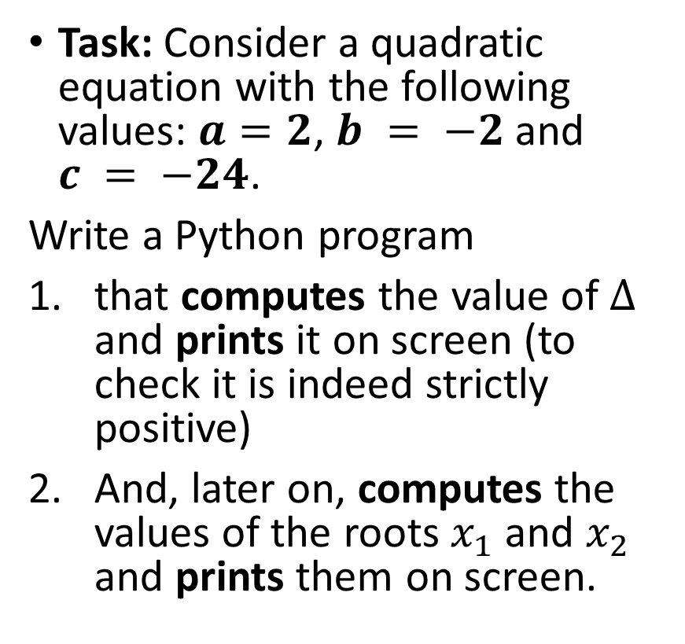
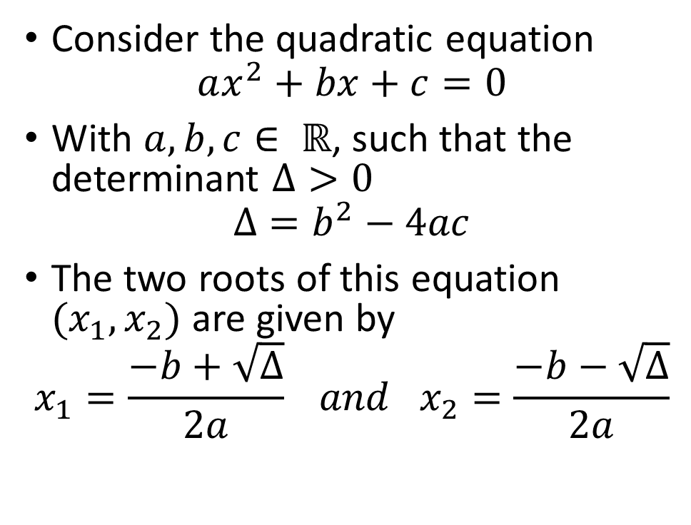
Activity 1: compute the roots of a quadratic equation, with strictly positive determinant
Consider the quadratic equation
$$ax^{2}+bx+c=0$$
With $a, b, c∈ ℝ$, such that the determinant $Δ>0$
$$Δ=b^{2}−4ac$$
The two roots of this equation $(x_{1},x_{2})$ are given by
$$x_{1}=\frac{−b+\sqrt{Δ}}{2a} and x_{2}=\frac{−b−\sqrt{Δ}}{2a}$$
Task: Consider a quadratic equation with the following values: $a=2$, $b = −2$and $c = −24$.
Write a Python program
that computes the value of $Δ$ and prints it on screen (to check it is indeed strictly positive)
And, later on, computes the values of the roots $x_{1}$ and $x_{2}$ and prints them on screen.
→ Expected answers: $Δ=196$, $x_{1}=4$, $x_{2}=−3$.

Slide 36
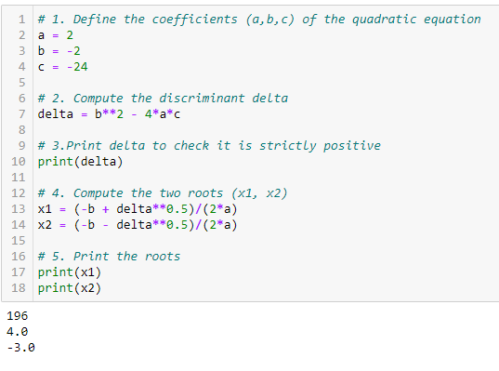
Activity 1: compute the roots of a quadratic equation, with strictly positive determinant

Slide 37
Activity 1: compute the roots of a quadratic equation, with strictly positive determinant
The solved notebook is in the Activity Solutions subfolder!

Slide 38
Single line comments
Single line comments help the reader understand what is happening in your code.
On heavy programming projects, with several programmers, these are simply essential.

Slide 39
Single line comments
Single line comments help the reader understand what is happening in your code.
On heavy programming projects, with several programmers, these are simply essential.
Single line comments are also great if you want to use separators in your code. Personally, I use
# ----------------------------------------

Slide 40
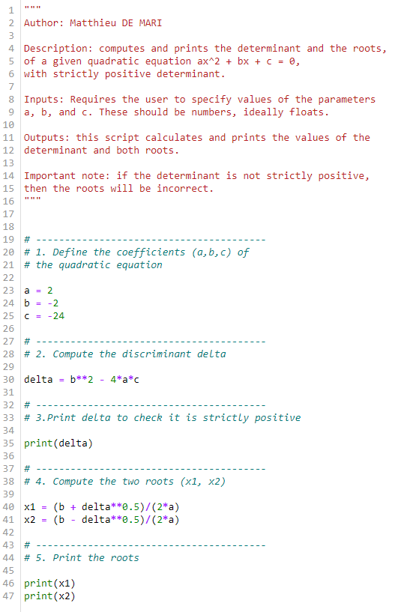
Single line comments
Single line comments help the reader understand what is happening in your code.
On heavy programming projects, with several programmers, these are simply essential.
Single line comments are also great if you want to use separators in your code. Personally, I use
# ----------------------------------------

Slide 41
Block comments
Block comments are comments starting and ending with triple quotation marks (“””).
These are great for headers in your files: specifying the author name, a brief description of what the script does, etc.

Slide 42
Block comments
Block comments are comments starting and ending with triple quotation marks (“””).
These are great for headers in your files: specifying the author name, a brief description of what the script does, etc.
All comments are ignored when executing the code, they only serve for description.

Slide 43
Matt’s Great advice #3
Matt’s Great Advice #3: comment your code.
It is always a good idea to comment your code, to let the reader know what your script does.
Either use # for single line comments or triple quotations (“””) for block comments. You can even use separators (# ------), for readability, if needed.
Again, your future self, and colleagues, will thank you, when they work on your code later on.

Slide 44
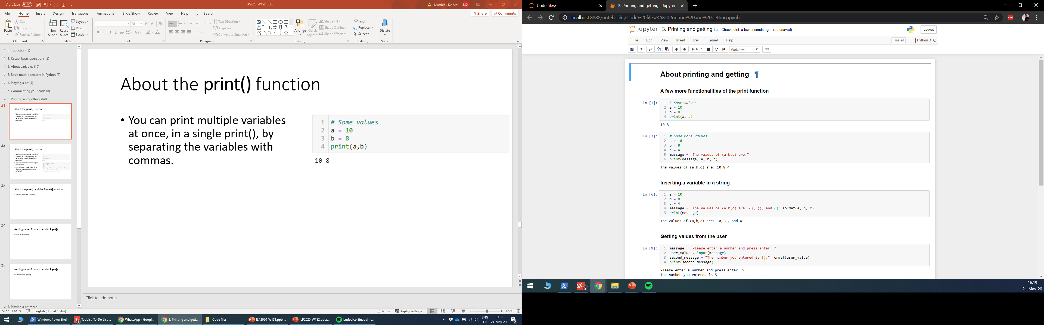
About the print() function
You can print multiple variables at once, in a single print(), by separating the variables with commas.

Slide 45
About the print() function
You can print multiple variables at once, in a single print(), by separating the variables with commas.
You can even mix several types of variables.
It is actually a good idea, to let the user know what you are printing!

Slide 46
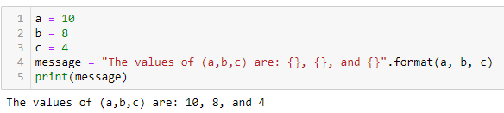
About the print(), and the format() function
The format() function can be used to insert the value of a variable in another string variable.

Slide 47
About the print(), and the format() function
The format() function can be used to insert the value of a variable in another string variable.
It requires some placeholders {} in the string, and some variables passed to the format() method. Placeholders are simply replaced with the values of the variables passed to the format() method.

Slide 48
About the print(), and the format() function
The format() function can be used to insert the value of a variable in another string variable.
It requires some placeholders {} in the string, and some variables passed to the format() method. Placeholders are simply replaced with the values of the variables passed to the format() method.
Note: format() is a special kind of function called a method. Notice how it is applied to a string variable using the dot operator.

Slide 49
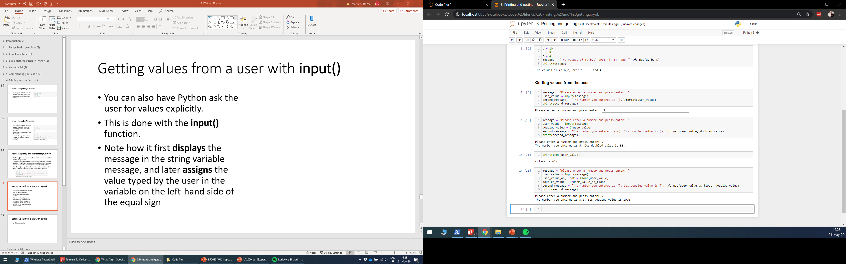
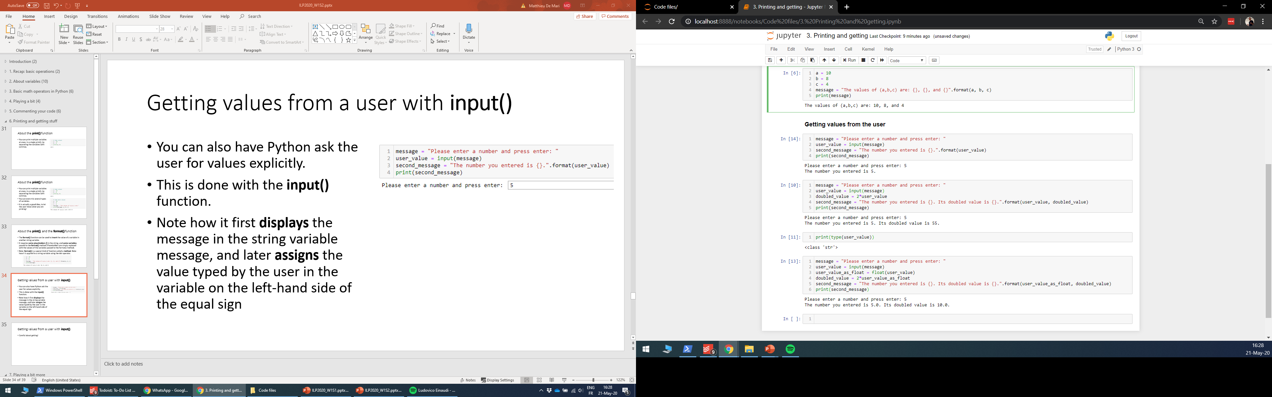
Getting values from a user with input()
You can also have Python ask the user for values explicitly.
This is done with the input() function.

Slide 50
Getting values from a user with input()
You can also have Python ask the user for values explicitly.
This is done with the input() function.
Notice how it
first displays the string variable message and submission box,
and later assigns the value typed by the user in the variable on the left-hand side of the equal sign used for input().

Slide 51
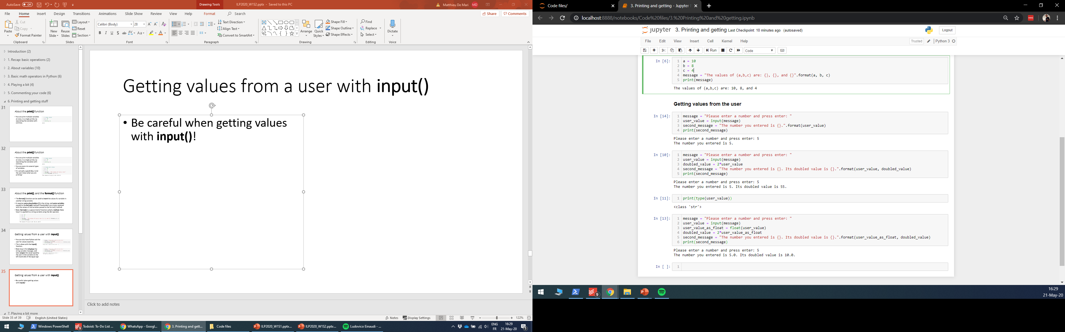
Getting values from a user with input()
Be careful when getting values with input()!
In this program,
I asked the user to enter a number,
Doubled the value of said number,
And later displayed both the original number and its doubled value.

Slide 52
Getting values from a user with input()
Be careful when getting values with input()!
In this program,
I asked the user to enter a number,
Doubled the value of said number,
And later displayed both the original number and its doubled value.
Something strange occurs… But why?

Slide 53
Has Python gone mad?

Slide 54
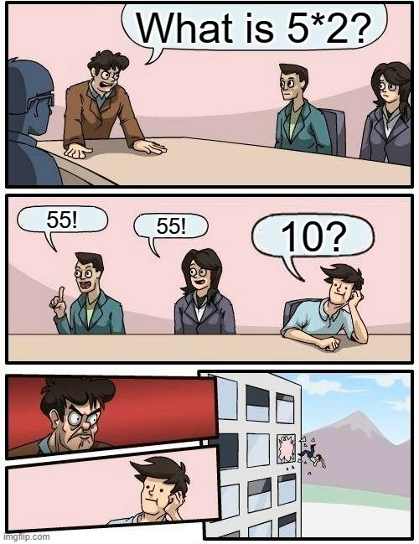

Has Python gone mad?

Slide 55
Getting values from a user with input()
Important: The values retrieved from users with input() will always be typed as string variables!

Slide 56
Reminder! (Python basic operators)
By default, Python comes with a few basic math operators, for number (int/float) variables.
+: addition
-: subtraction
*: multiplication
/: division
//: integer division
%: remaining of the integer division (a.k.a. modulus)
**: exponentiation

Slide 57
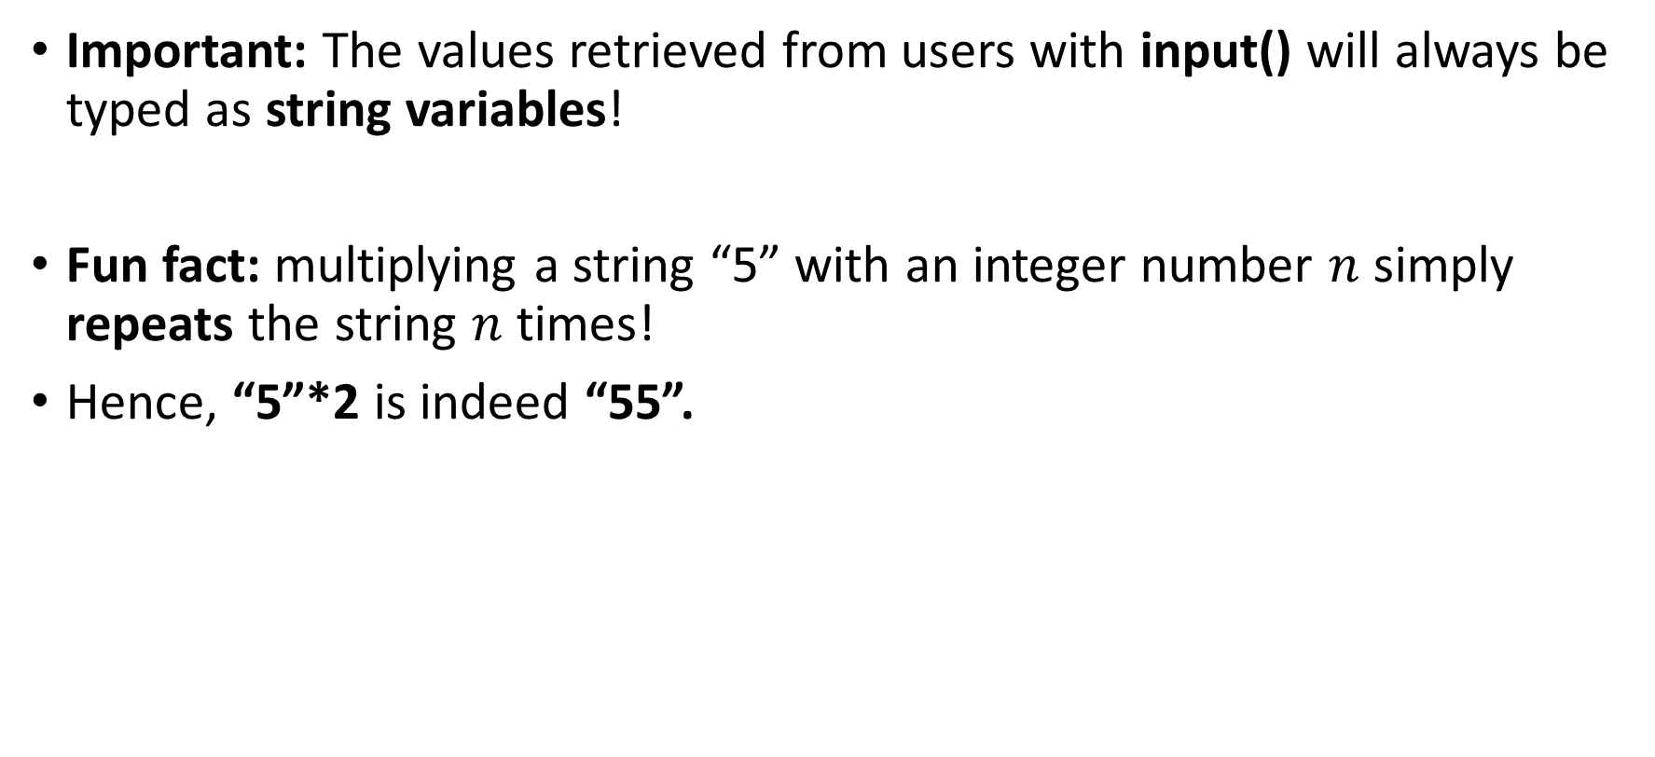
Getting values from a user with input()
Important: The values retrieved from users with input() will always be typed as string variables!
Fun fact: multiplying a string “5” with an integer number $n$ simply repeats the string $n$ times!
Hence, “5”*2 is indeed “55”.

Slide 58
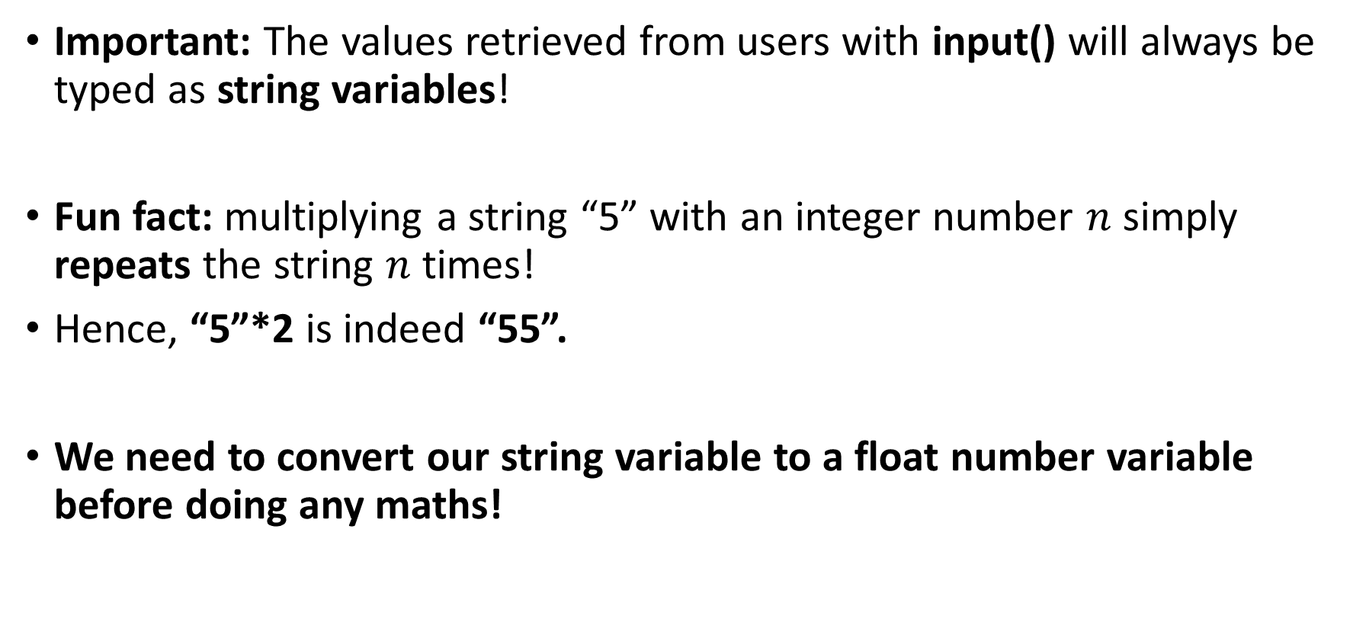
Getting values from a user with input()
Important: The values retrieved from users with input() will always be typed as string variables!
Fun fact: multiplying a string “5” with an integer number $n$ simply repeats the string $n$ times!
Hence, “5”*2 is indeed “55”.
We need to convert our string variable to a float number variable before doing any maths!

Slide 59
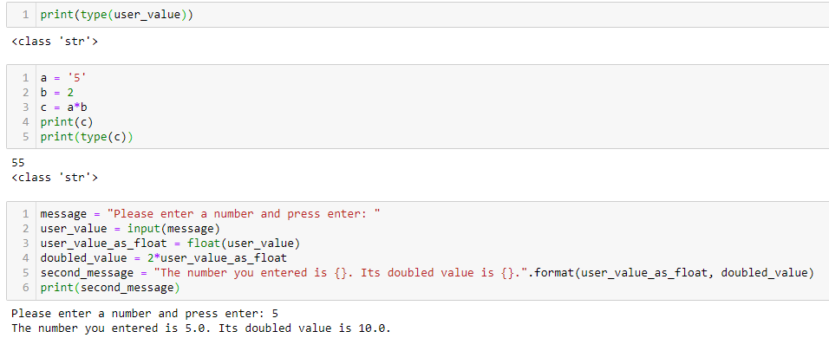
Getting values from a user with input()

Slide 60
Matt’s Great advice #4
Matt’s Great Advice #4: watch out for types when using basic math operators!
The behavior of a basic math operator (+, -, *, etc.) might vary, depending on the types of the variables involved in the calculation.
This is called operator overloading, and is a perfectly normal feature of Python programming.
For instance, multiplying a string and a number variables, is not the same as multiplying two number variables!

Slide 61
Activity 2: Ask users about personal details
Task: Write a Python script that explicitly asks the user for its name and its age.
Later on, the scripts should display a message, reading
Your name is: _________, and your age is ____.
You can use the second notebook
Activity 2 - Asking users for personal details.ipynb

Slide 62
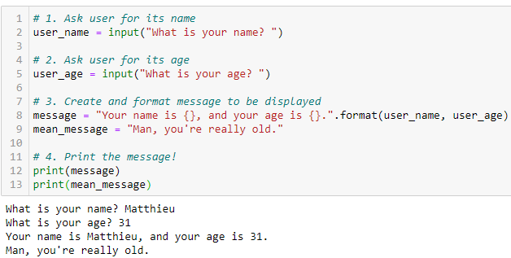
Activity 2: Ask users about personal details

Slide 63
Conclusion
Variables: Naming conventions, types, IDs, assignments, conversions
Basic math operators in Python: +, -, *, /, //, %, **
Combining operators and assignments
Commenting: in-line, block, docstring and header comments
Printing and getting: displaying with print(), getting with input()
Bonus (out-of-class , if time allows!): what happens backstage when I run my code?

Slide 64
Decomposing the code compilation and execution procedure
Python code file file.py
Lexical analysis and tokenization
Semantic analysis
Syntax analysis
Intermediate code and optimization
UASM/Binary instructions generation and execution
From the moment you submit your code and the moment it executes, 5 steps happen
Lexical analysis and tokenization
Syntax analysis
Semantic analysis
Intermediate code and optimization
UASM/binary instructions generation and execution

Slide 65
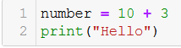
Lexical analysis and tokenization
This first step

Slide 66
Lexical analysis and tokenization
This first step
Breaks down the code in small pieces, i.e. “words” (e.g. number, =, 10, +, 3, print, (, “Hello”, ),…)

Slide 67
Lexical analysis and tokenization
Value
Value
Assignment operator
Additive operator
Variable
name
This first step
Breaks down the code in small pieces, i.e. “words” (e.g. number, =, 10, +, 3, print, (, “Hello”, ),…)
And attempts to identify what each piece/”word” represents, a.k.a. tokenization (e.g. number is a variable name, = is the assignment operator, 10 is a numerical value, + is the additive operator, etc.)
Function name
Text
Opening parenthesis
Closing parenthesis

Slide 68
Syntax analysis
This second step
Checks for code structure, and language accuracy. = Does it follow the expected language structure? (e.g. there should be a valid variable name before an assignment operator and a valid value after it, a function expects parameters between parentheses immediately after, etc.)

Slide 69
Syntax analysis
Then,
If it passes this first step, it starts to construct a tree structure for the operations to be conducted.
It defines the successive operations to be taken for the given code.
Create value 10
Create value 3
Add both values
Assign addition result to a variable with name number
Etc.

Slide 70
3. Semantic analysis
This third step checks for semantics (= logical meaning of the code). For instance,

Slide 71
3. Semantic analysis
This third step checks for semantics (= logical meaning of the code). For instance,
Does the function name exist?
Are we using or printing a variable that has been previously defined?
Is it allowed to add the values defined earlier together? (if both are numbers yes, if one is a number and the other is text, no)
Etc.

Slide 72
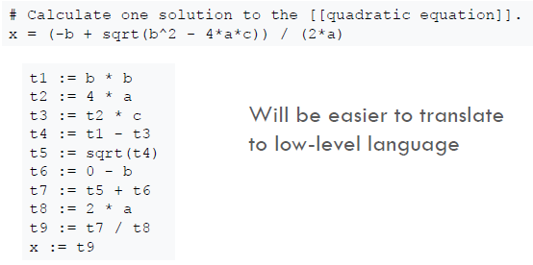
4. Intermediate code and optimization
Intermediate Code: assuming the code makes sense, convert the easy-to-read Python instructions into less readable instructions, which the computer can then execute.
Original source code (from file.py)
Intermediate code

Slide 73
4. Intermediate code and optimization
Intermediate Code: assuming the code makes sense, convert the easy-to-read Python instructions into less readable instructions, which the computer can then execute.
Optimization: Memory allocation for variables, CPU processing resource allocation and distribution.
Original source code (from file.py)
Intermediate code

Slide 74
4. Intermediate code and optimization
Intermediate Code: assuming the code makes sense, convert the easy-to-read Python instructions into less readable instructions, which the computer can then execute.
Optimization: Memory allocation for variables, CPU processing resource allocation and distribution.
(Not covered, too advanced)
Original source code (from file.py)
Intermediate code

Slide 75
5. Code generation and execution
Assembly code: converts the intermediate code into binary code (0/1), which can be executed by the CPU of your computer!
(This is cumbersome to explain, but will make sense during the Computational Structures course on Term 4!)
Finally, execute the assembly code
and see the results!

Slide 76
Compiled vs. Interpreted languages
Compiled language (e.g. C/C++)
Interpreted language (e.g. Python)
Scans the whole file and translates it into assembly code all at once.
Overall, faster to compile and execute.
Will not execute anything if there is an error somewhere, making it hard to debug.
Scans the source file, one operation at a time.
Slower compilation and execution.
If an error exists, it will execute the lines of code before the one that triggered the error.
Much easier to debug, and hence more beginner-friendly.

